Slide 1
The impact of Basel III implementation on bank lending in South Africa
Xolani Sibande and Alistair Milne

Slide 2
Motivation for the study
We investigated the impact of the higher regulatory capital requirements of the implementation of the Basel III in South Africa between 2013 and 2019.
Basel III capital requirements have been shown to reduce bank lending in other markets (for UK Aiyar et al. (2014))
Limited work exists in this area in South Africa
Focus on a small set of large banks has some advantages: business models of these banks are similar
Our empirical specification follows previous studies of the impact of capital requirements on bank credit supply (for Peru Fang et al. (2020))

Slide 3
Balance sheet data is rich
We collected data on the four major South African banks: Absa Bank, Standard Bank, First National Bank, and Nedbank
Mainly utilised the BA900s (bank economic returns) and the BA930s (bank product lending rates)
From the Prudential Authority, we also collected the controls data
We focus on real economic activity lending in the BA900s is represented by lending to households and non-financial corporations.
However, the BA900s only report granular lending categories to households and non-financial corporations. Therefore, some aggregation was necessary.
This aggregation essentially limited our sample to the big four lenders
Three major categories for households and non-financial corporations (secured, unsecured, and mortgages)

Slide 4
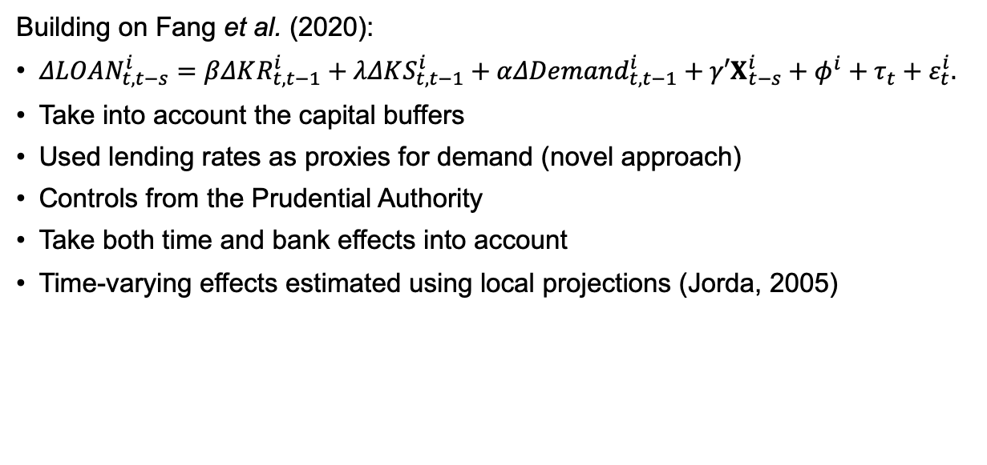
We used a panel model approach
Building on Fang et al. (2020):
$ΔLOAN_{t,t−s}^{i}=βΔKR_{t,t−1}^{i}+λΔKS_{t,t−1}^{i}+αΔDemand_{t,t−1}^{i}+γ′X_{t−s}^{i}+φ^{i}+τ_{t}+ε_{t}^{i}.$
Take into account the capital buffers
Used lending rates as proxies for demand (novel approach)
Controls from the Prudential Authority
Take both time and bank effects into account
Time-varying effects estimated using local projections (Jorda, 2005)

Slide 5
Results indicate little evidence of the impact
While our set up is similar to Fang et al. (2020), we find very much weaker evidence of an impact of capital requirements on the supply of bank lending.
Only in the case of secured credit for non-financial corporations do we obtain a statistically significant and economically sensible coefficient estimates and the coefficient is relatively small.
Exploring alternative dynamic estimation similarly yields little evidence of any.
This is not a surprising results given that these bank are well capitalised.
However, there are data and methodological issues that could be further explored in future work.

